Slide 1
ML practical know-hows
Danny Hendler
hendlerd@post.bgu.ac.il
Amir Rubin
amirrub@post.bgu.ac.il

Slide 2
Agenda
Part A: Features
Features quality and contribution
Part B: Models
Framing – model and hyper parameters selection
Confusion matrix
ROC and AUC
Cross validation
Time-split
Part C: hands on

Slide 3
Features quality and contribution
Before ML: estimate the quality
Distribution clean vs malicious
After ML: asses the contribution
Analyze features
Linear classifier – what is the weight of the feature?
Trees - structure

Slide 4
Features quality and contribution
Before ML
How can we estimate the quality of a feature? mini demo
Label | F1 | F2 | F3
0 | 0 | 1 | 10
0 | 1 | 10 | 0
0 | 2 | 3 | 9
0 | 0 | 12 | 1
1 | 10 | 2 | 2
1 | 10 | 11 | 11
1 | 11 | 0 | -1
1 | 12 | 9 | 12

Slide 5
Part B: Models
Framing – model and hyper parameters selection
Confusion matrix
ROC and AUC
Cross validation
Time-split

Slide 6
Part B: Models
Framing – model and hyper parameters selection
We have various models, and for each we may have various “hyper parameters” – model parameters
(step size, leaf size etc).
id | label | probability
1 | 1 | 0.9
2 | 1 | 0.8
3 | 1 | 0.9
4 | 1 | 0.1
5 | 1 | 0.6
6 | 0 | 0.6
7 | 0 | 0.9
8 | 0 | 0.1
9 | 0 | 0.2
10 | 0 | 0.2
id | label | probability
1 | 1 | 0.9
2 | 1 | 0.8
3 | 1 | 0.9
4 | 1 | 0.1
5 | 1 | 0.6
6 | 0 | 0.6
7 | 0 | 0.9
8 | 0 | 0.1
9 | 0 | 0.2
10 | 0 | 0.2
id | label | probability
1 | 1 | 0.9
2 | 1 | 0.8
3 | 1 | 0.9
4 | 1 | 0.1
5 | 1 | 0.6
6 | 0 | 0.6
7 | 0 | 0.9
8 | 0 | 0.1
9 | 0 | 0.2
10 | 0 | 0.2
id | label | probability
1 | 1 | 0.9
2 | 1 | 0.8
3 | 1 | 0.9
4 | 1 | 0.1
5 | 1 | 0.6
6 | 0 | 0.6
7 | 0 | 0.9
8 | 0 | 0.1
9 | 0 | 0.2
10 | 0 | 0.2
id | label | probability
1 | 1 | 0.9
2 | 1 | 0.8
3 | 1 | 0.9
4 | 1 | 0.1
5 | 1 | 0.6
6 | 0 | 0.6
7 | 0 | 0.9
8 | 0 | 0.1
9 | 0 | 0.2
10 | 0 | 0.2
id | label | probability
1 | 1 | 0.9
2 | 1 | 0.8
3 | 1 | 0.9
4 | 1 | 0.1
5 | 1 | 0.6
6 | 0 | 0.6
7 | 0 | 0.9
8 | 0 | 0.1
9 | 0 | 0.2
10 | 0 | 0.2

Slide 7
Part B: Models
We need a way to qualify the results of a model
We care about TP, FP, TN, FN

Slide 8
Step 1: Confusion matrix
For a given Threshold (0.5), calculate TP, FN, FP, TN:
id | label | probability
1 | 1 | 0.9
2 | 1 | 0.8
3 | 1 | 0.9
4 | 1 | 0.1
5 | 1 | 0.6
6 | 0 | 0.6
7 | 0 | 0.9
8 | 0 | 0.1
9 | 0 | 0.2
10 | 0 | 0.2
 |  |  | Prediction
 |  |  | 1 |  | 0
Truth | 1 | TP |  | FN
 | 0 | FP |  | TN

Slide 9
Step 1: Confusion matrix
Threshold 0.5
id | label | probability
1 | 1 | 0.9
2 | 1 | 0.8
3 | 1 | 0.9
4 | 1 | 0.1
5 | 1 | 0.6
6 | 0 | 0.6
7 | 0 | 0.9
8 | 0 | 0.1
9 | 0 | 0.2
10 | 0 | 0.2
Changes with every Threshold!
 |  |  | Prediction
 |  |  | 1 |  | 0
Truth | 1 | TP | 4 | FN | 1
 | 0 | FP | 2 | TN | 3

Slide 10
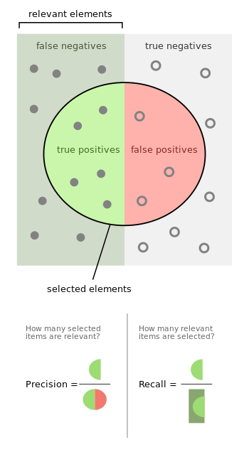
Step 2: Precision – Recall - Accuracy
Precision:
“hit” as 1/classified as 1
TP/(TP+FP)
Recall:
“hit” as 1/ is 1
TP/(TP+FN)
Accuracy:
(TP+TN)/(TP+FP+TN+FN)
Which is more important?
 |  |  | TRUE
 |  |  | 1 |  | 0
Predicton | 1 | TP | 4 | FN | 1
 | 0 | FP | 2 | TN | 3

Slide 11
Step 2: Precision – Recall - Accuracy
Precision:
“hit” as 1/classified as 1
TP/(TP+FP) 4/6
Recall:
“hit” as 1/ is 1
TP/(TP+FN) 4/5
Accuracy:
(TP+TN)/(TP+FP+TN+FN) 7/10
 |  |  | Prediction
 |  |  | 1 |  | 0
Truth | 1 | TP | 4 | FN | 1
 | 0 | FP | 2 | TN | 3
Changes with every Threshold!

Slide 12
Step 3: ROC
Receiver-operator characteristic
Per TH calculate the TPR and FPR:
TRP: TP/(TP+FN) recall
FPR: FP/(FP+TN)

Slide 13
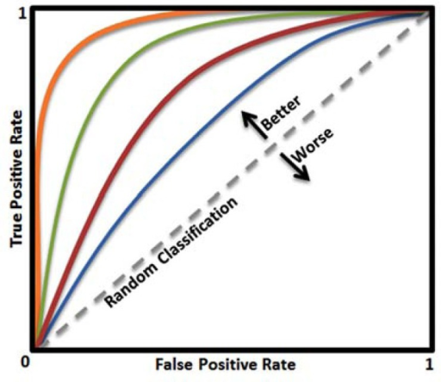
Step 3: ROC
TH=0
TH=1
Notes:
At TH 0 – no one is labeled as 1 – no TP no FP
At TH 1- all labeled as 1 – all TP all FP
Random – at any TH the amount of TP is simply the amount of TP who got less than that TH – as scores are random, this is exactly TH. Same for FPs.

Slide 14
Step 3: AUC
Area under the curve
0 to 1
Higher is better
Is it all we care about?

Slide 15
Step 3: AUC
0.74
0.625
FPR
Notes:
If we are super sensitive to FP – the Blue is better!

Slide 16
Quick summery
Given a classifier and labeled data, we can use AUC to get an estimation of it
0<AUC<1, higher is better
Most ML toolkits have AUC built in them

Slide 17
Cross validation
How can we estimate if the classifier is good using AUC?
Lets split the data to “train” and “validate”!
What if the split was problematic?
Split to more pieces!

Slide 18
Cross validation
Perform train-validate k times
Take the average score

Slide 19
Time split cross validation
Split the data according to the time seen

